Slide 1
Hawkesbury Media Network Association STRATEGIC PLAN 2025-2027 DRAFT ONLY

Slide 2
Acknowledgement of Country
Hawkesbury Media Network Association (PulseFM) respectfully acknowledges the Traditional Custodians of the lands upon which we broadcast-the Darug and Darkinjung people. We acknowledge their elders, past, present and emerging and extend that respect to all Aboriginal and Torres Straight Islander people. We recognize their enduring connection to this land and its waters.
Pulsefm is committed to developing a Reconciliation Action Plan during the period of this Strategic Plan that sustainably and strategically takes meaningful action to advance reconciliation.

Slide 3
Executive Summary
Pulse 89.9fm was awarded the RA1 Hawkesbury Community license on 6th December 2022. This was a new station with a team of volunteers prepared to rebuild the trust in Community Radio in our Area. We are a community-run grassroots radio station.
Our Community is diverse with some areas isolated due to the topography of our region. Our team of volunteers has grown from 4 to 37 in 2 years, with over 47 radio programs each week with a focus on new Australian talent, our culture and genre-based music. We promote the voices of women, LGBTIAQ+, First Nations people, workers, and people with a disability.
Pulse 89.9fm aims to become a leading community radio station that actively engages its audiences through diverse programming while fostering education and training, community engagement, business development and sound business protocols.
This strategic plan outlines the core pillars and initiatives that will guide our efforts over the next three years to strengthen our community ties, enhances our capabilities and ensures our sustainable growth.

Slide 4
Vision, Mission and Values
Vision Statement
To be the heartbeat of our community delivering relevant programming and empowering voices through programming training and education, technology, community engagement and business development
Mission Statement
At Pulse 89.8fm we are dedicated to fostering to fostering a vibrant community though diverse and inclusive programming that reflects the voices, cultures and interests of the Hawkesbury region. Our mission is to engage, educate and empower our listeners by providing a platform for local stories, music and dialogue while embracing the core values of integrity, inclusivity and respect.
As a not-for –profit organization we prioritise sound governance principles and uphold financial sustainability to ensure the longevity and impact of our station. We are committed to transparent operations and effective business protocols that serve our community’s best interests.
Together, we aim to create a listening environment that not only entertains but also inspires connection and collaboration among residents, fostering a sense of belonging in the rich tapestry of the Hawkesbury community. Through our efforts, we strive to enhance the cultural landscape of our region and contribute positively to its growth and wellbeing.

Slide 5
Our values: We are committed to integrity by fostering a transparent and honest environment, promoting inclusivity to ensure every voice is heard and embodying respect in all our interactions.
Integrity
We will demonstrate reliability, accountability and trustworthiness fostering a sense of credibility and respect among our peers and the community.
Inclusive
We will create an environment in which all individuals regardless of their background or ability will feel welcomed, respected and valued.
Respect
We will recognize and appreciate the inherent worth and dignity of individuals and their rights, beliefs, values and feelings.

Slide 6
1. Governance and Administration: We will deliver appropriate governance protocols and sound business principles that meets the needs of our stakeholders to ensure our objectives is delivered in an efficient and effective manner.
PILLAR | OBJECTIVE | MEASURES
Governance and Administration | To strengthen our governance structures and procedures to ensure sound financial management for ongoing sustainability. | Annual financial results Board stability Policies and procedures Adherence to ACMA and CBA
MAJOR INITIATIVES
Board Development. Recruit a maintain a diverse and skilled board of directors to provide effective oversight and strategic direction of the station.
Financial Planning and Budgeting. Conduct annual financial planning workshops to develop clear budgets, forecasting and fundraising
strategies.
Grant writing and Funding Sources. Invest in grant writing training for staff/volunteers to identify and apply for grants that support
community radio stations activities and growth.
Membership Program. Launch annually a membership program to encourage community support and provide exclusive benefits to
members.

Slide 7
2. Programing and content: We will deliver relevant programing and associated content that and become the voice of the community blending conversation, music and up to date news and local issues.
PILLAR | OBJECTIVE | MEASURES
Programming and content | To enhance programming quality and diversity to reflect community interests and needs. | Audience satisfaction
MAJOR INITIATIVES
Content Development Workshop. Organise collaborative workshops with local artists, community members, content creators to develop shows that feature local culture, news, information and local music.
2. Thematic Programming Blocks. Create thematic weekly program blocks including health, education, arts, all abilities, gender equity, indigenous and multicultural to ensure a broader perspective and attract a broader audience.
Audience Feedback Mechanism. Implement a feedback system (via surveys, social media etc) to gather community input about
program preferences and changes.
Youth Programming. Develop a dedicated time slot for youth – led by content produced by local schools and youth organisations
to engage younger demographics.

Slide 8
3. Education and Training: We will be accessible and inclusive to all and provide training as required to create programs via research and technical skills to ensure quality radio is delivered to the community.
PILLAR | OBJECTIVE | MEASURES
Education and Training | To empower current presenters and community members through skill-building and training opportunities to contribute to the stations ongoing development. | No of people trained Diverse programming Improved production quality
MAJOR INITIATIVES
Volunteer Training Program. Establish a comprehensive training program for volunteers covering all aspects of radio
radio production, including technical skills, hosting, and content development.
Workshops with local experts. Partner with local educators and industry professionals to offer workshops on journalism, media ethics
and digital storytelling.
Internships and Mentorship. Create internship programs for students and recent graduates to gain practical experience while being
mentored by experienced staff.
Online Learning Resources. Develop a resource hub and guides on topics related to radio broadcasting and
production.

Slide 9
4. Community Engagement: We recognize isolation is a concern due to the topography of the Hawkesbury and we will engage with local people to open lines of communication and give people a sense of connection and worth.
PILLAR | OBJECTIVE | MEASURES
Community Engagement | To foster deeper connections within the community and build a loyal listenership. | No of outside broadcasts Partnerships Digital media metrics
MAJOR INITIATIVES
Community Events. Host regular community events (eg open mic nights, community events) tom promote local talent
and engage with the audience and participants.
Partnerships with Local Organisations. Collaborate with local not-for-profits, schools, and businesses for co-hosted programming and joint initiatives.
Social Media Engagement. Develop a robust social media strategy to connect with audiences, promote programming and encourage user generated content.
Focus Groups. Establish focus groups to regularly consult community members on current issues, interests, and programming effectiveness.

Slide 10
5. Business Development: We will contribute to a strong community by helping when required while engaging with businesses to establish mutual benefits.
PILLAR | OBJECTIVE | MEASURES
Business Development | To make a positive contribution to the broader community including the business sector of the Hawkesbury and explore new avenues for revenue generation and sustainability. | Revenue uplift Brand recognition No of events
MAJOR INITIATIVES
Sponsorship and Advertising Packages. Develop attractive sponsorship and advertising packages for local businesses focusing on what makes Pulsefm unique.
Merchandising. Explore creating brand merchandise, such as apparel and accessories to promote the station and generate income.
Community Funding Initiatives. Organise fund raising events that can potentially assit funding the station but also engage and support the community.
Collaborative Projects. Seek partnerships with local businesses for co-branded events that enhance visibility and create shared promotional opportunities.

Slide 11
6. Technological and software development: We will utilize our equipment and software to connect with the community and keep abreast of technological advancements to ensure the best quality production and quality.
PILLAR | OBJECTIVE | MEASURES
Technological and software development | To leverage technology to enhance broadcasting capabilities and audience reach. | Equipment upgrades Podcasts
MAJOR INITIATIVES
Upgrade Broadcasting Equipment. Continue to invest in modern broadcasting equipment to improve audio quality and reliability.
Website and Mobile App Development. Continue website and mobile app accessibility for streaming content, accessing schedules and engaging with community members.
Podcasting Platforms. Explore options for cost effective and reliable platforms for podcasts featuring recorded shows, community stories and interviews to extend our reach beyond live radio.
Digital Archives. Create a digital archive of past shows and community history available for public access and educational purposes.

Slide 12
Monitoring and Evaluation, Conclusion.
Annual Review: Conduct an annual review of the strategic plan with the board and community members to assess progress on objectives.
Key Performance Indicators (KPI’s): Establish KPI’s for each initiative eg listener engagement metrics, number of training participants and financial growth.
Community Feedback: Regularly engage with the community for feedback on programming, events, initiatives to adapt strategies accordingly.
By executing this strategic plan, Pulsefm will strengthen its position as a vital community institution, fostering connection, empowerment and sustainability. By focusing on collaborative programming, education, engagement, governance, technology and business development we can ensure a vibrant and sustainable future for our station and community.

Slide 13
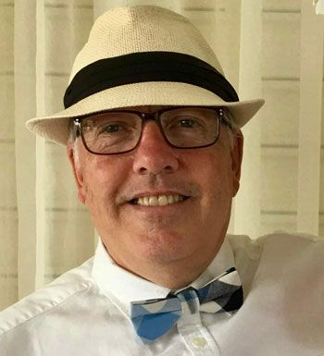
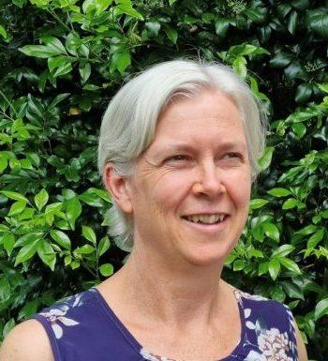
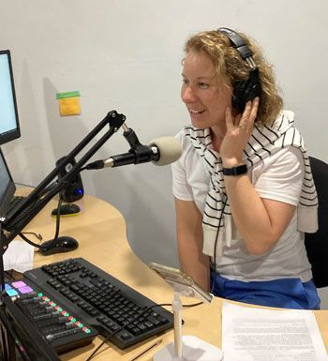
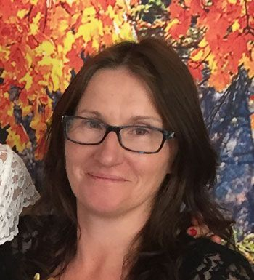
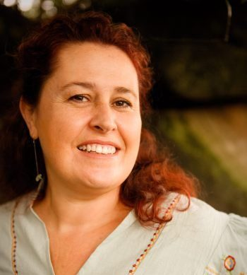
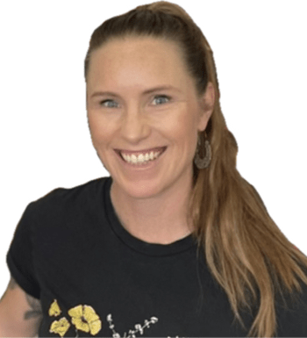
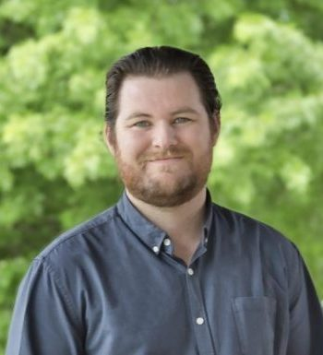
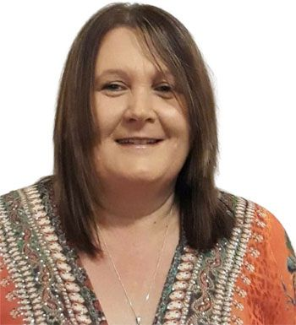
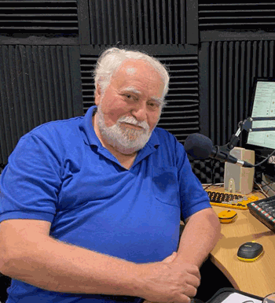
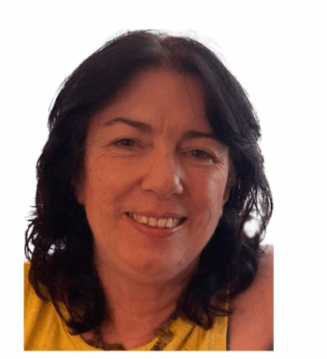
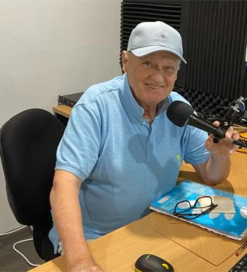
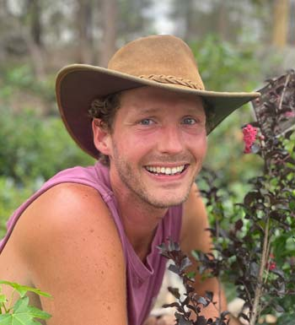
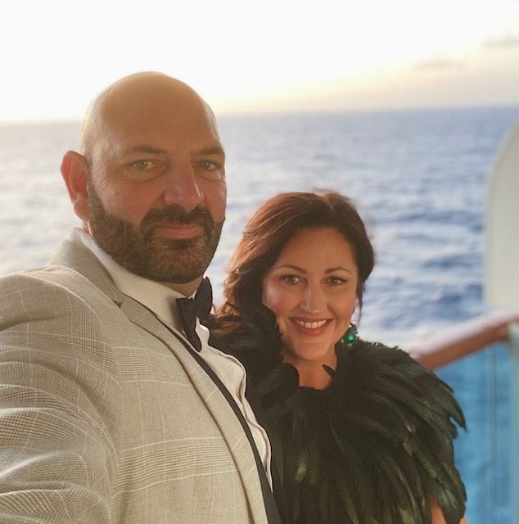
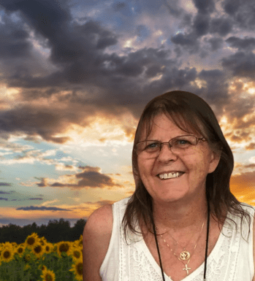
Our people and culture will define everything we do and reflect our community expectations for a values-based broadcasting organization in the Hawkesbury.

